Slide 1

Hak4Kidz 2019 Badge
Behind the scenes & Getting Started

Slide 2
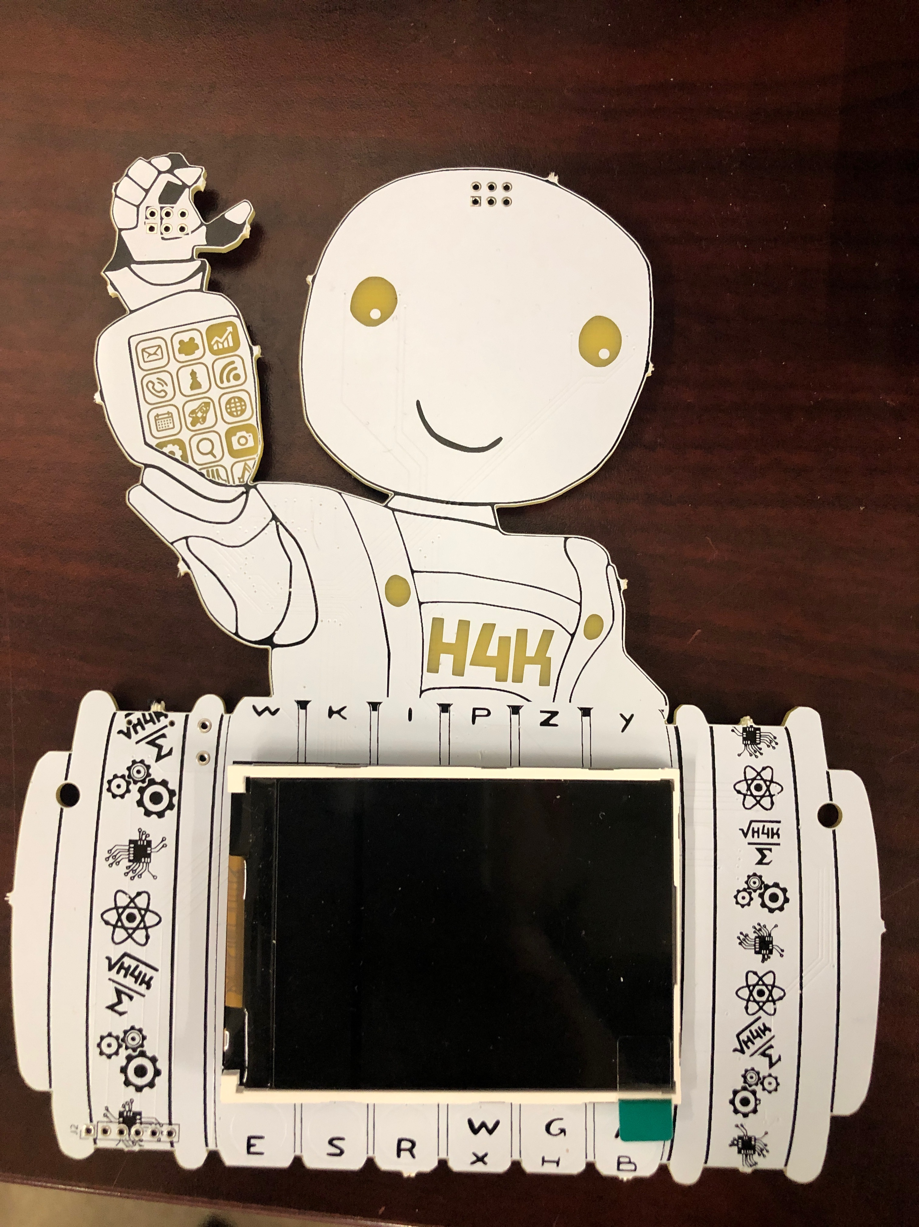
Here’s the Badge

Slide 3
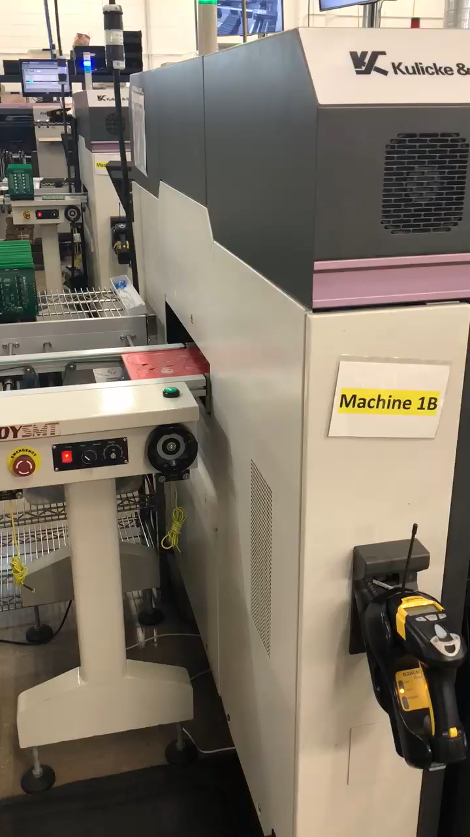

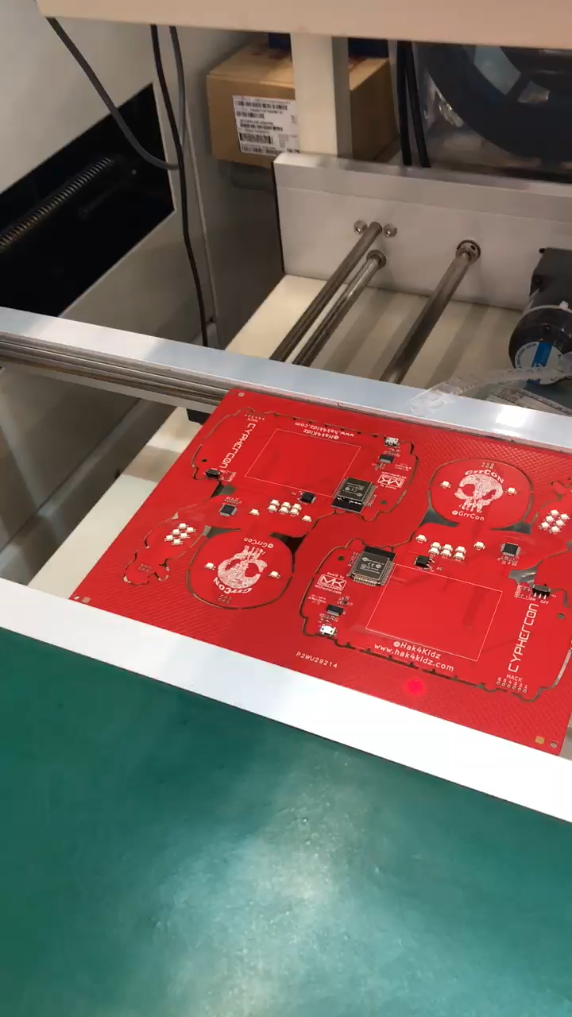
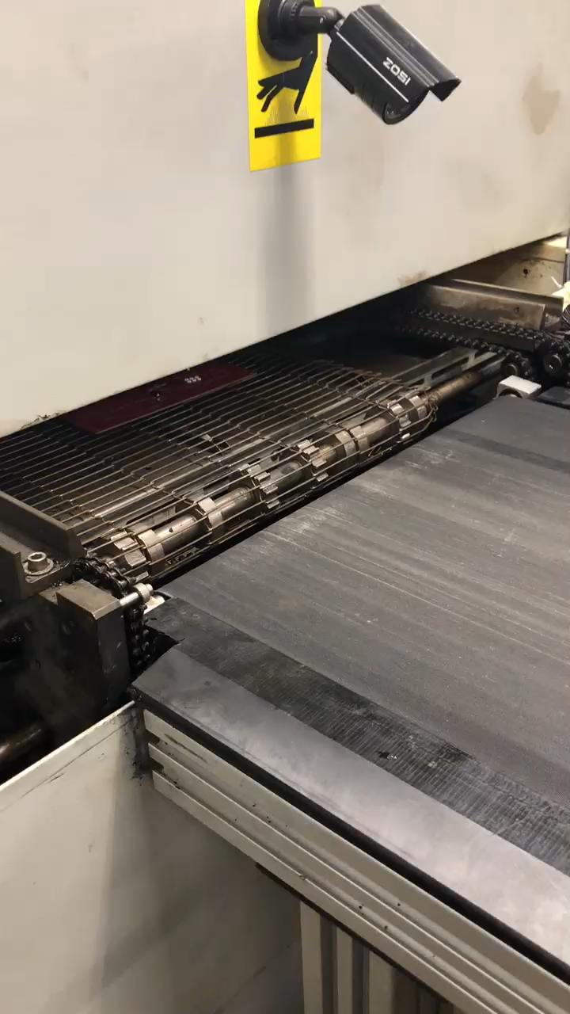
Here ARE the Badges Being Made

Slide 4
ESP32 Main Processor Uses
Manufactured by Espressif Systems
ESP32-WROOM-32 MCU (Microcontroller Unit) Features
Low-power sensor networks
Voice encoding
Music streaming
MP3 decoding
Video gaming
Cool badges!
Up to you!!!

Slide 5
Meet ESP32

Slide 6
ESP32 Specifications
Processors:
CPU: Xtensa dual-core 32-bit LX6 microprocessor
operating at 160 or 240 MHz and performing at up to 600 DMIPS
Ultra low power (ULP) co-processor
Memory: 520 KiB SRAM
Wireless connectivity:
Wi-Fi: 802.11 b/g/n
Bluetooth: v4.2 BR/EDR and BLE
Source: Wikipedia https://en.wikipedia.org/wiki/ESP32

Slide 7
ESP32 Specifications Continued
Peripheral interfaces:
12-bit SAR ADC up to 18 channels
2 × 8-bit DACs
10 × touch sensors (capacitive sensing GPIOs)
4 × SPI
2 × I²S interfaces
2 × I²C interfaces
3 × UART
SD/SDIO/CE-ATA/MMC/eMMC host controller
SDIO/SPI slave controller
Ethernet MAC interface with dedicated DMA and IEEE 1588 Precision Time Protocol support
CAN bus 2.0
Infrared remote controller (TX/RX, up to 8 channels)
Motor PWM
LED PWM (up to 16 channels)
Hall effect sensor
Ultra low power analog pre-amplifier
Source: Wikipedia https://en.wikipedia.org/wiki/ESP32

Slide 8
ESP32 Specifications Continued
Security:
IEEE 802.11 standard security features all supported,
including WFA, WPA/WPA2 and WAPI
Secure boot
Flash encryption
1024-bit OTP, up to 768-bit for customers
Cryptographic hardware acceleration: AES, SHA-2, RSA, elliptic curve cryptography (ECC), random number generator (RNG)
Power management:
Internal low-dropout regulator
Individual power domain for RTC
5μA deep sleep current
Wake up from GPIO interrupt, timer, ADC measurements, capacitive touch sensor interrupt
Source: Wikipedia https://en.wikipedia.org/wiki/ESP32

Slide 9
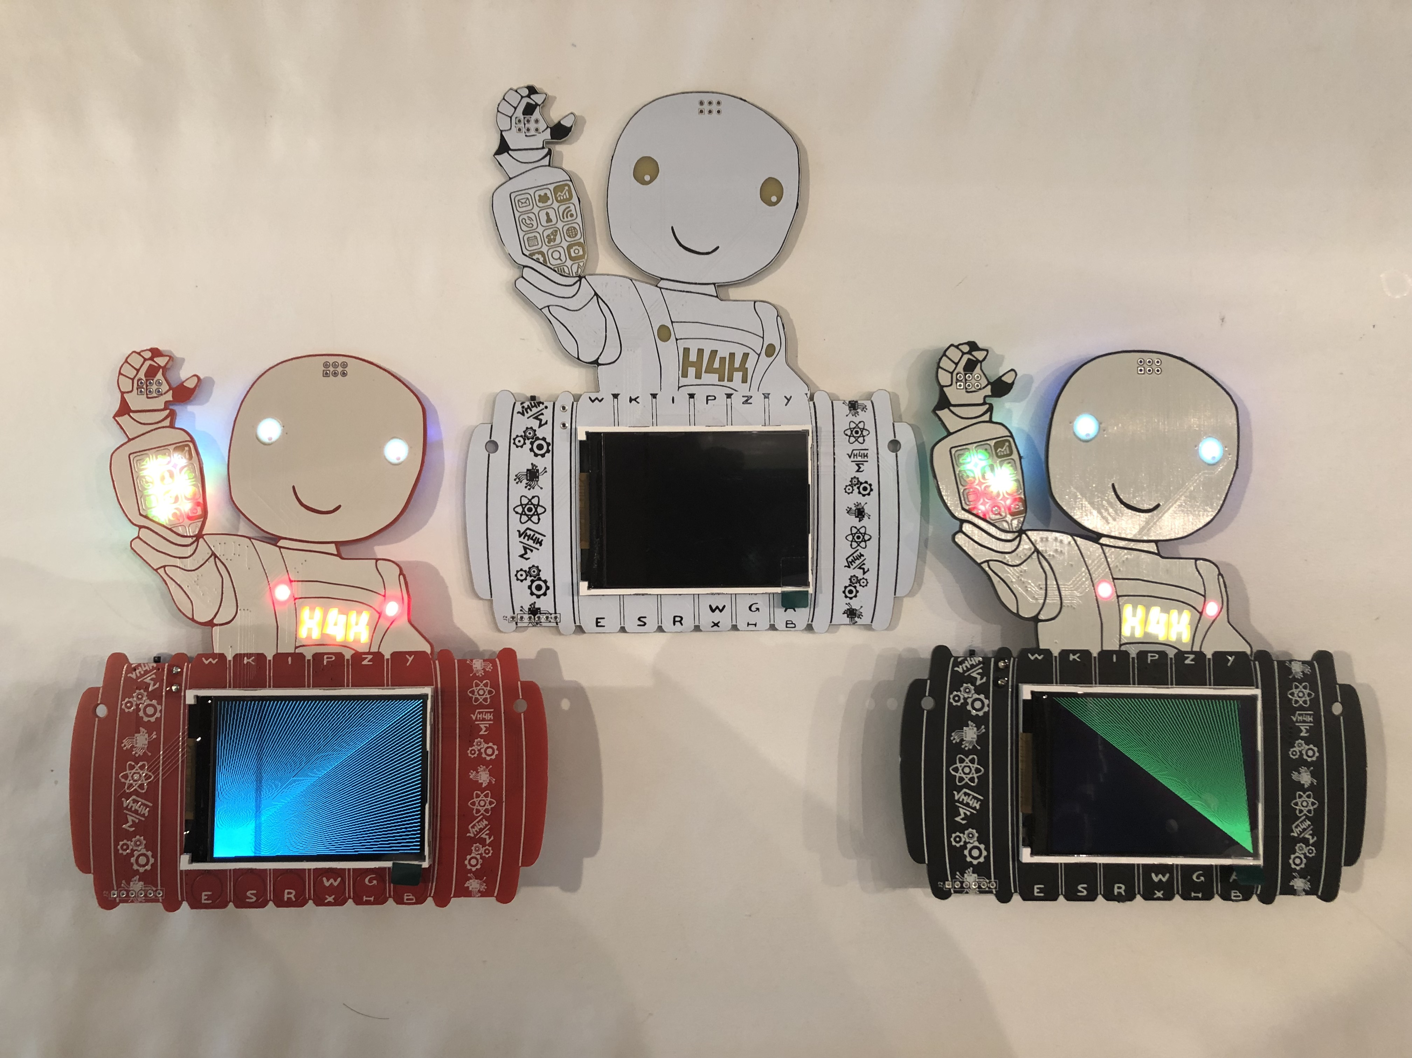
What else do the badges do?

Slide 10
How to program the badge terms
Sketch - the name of an Arduino program.
Board – programmable hardware to install your sketch onto.
Code – the sketch instructions for the board to run.
IDE – Integrated Development Environment to create / edit your sketch.
Library – a way to extend your sketch by adding extra functionality.
Compile – converts human readable code to computer readable byte code.
Upload – compile and install your sketch to your board.
Verify – Arduino IDE feature to check your sketch code before you upload to the board

Slide 11
How to program Using Arduino
Download & install the Arduino IDE from https://www.arduino.cc/en/Main/Software for your computer type.
Open Preferences
Go to Additional Boards Manager URLs:
Enter https://dl.espressif.com/dl/package_esp32_index.json

Slide 12
How to program – Add the ESP32 Board Manager
Tools / Board / Board Manager search for ‘ESP32’.
Click Install. Wait.
Go to https://github.com/Hak4Kidz/H4K-badge-2019
Download libraries from software / Arduino / libraries
Put files in Docs / Arduino / libraries folder

Slide 13
How to program – Connect Badge Hardware
Remove the badge from your neck
Connect USB cable end to computer
Connect micro-USB cable end to badge connector
Arduino / Tools / Board “ESP32 Wrover Module”
Select Tools / Port and the port name ie COM 3
Test connection using Tools / Get Board Info

Slide 14
How to program – Open the badge sketch
Download badge sketch from github
https://github.com/Hak4Kidz/H4K-badge-2019
File named 2019_Tyro_Badge.ino
Arduino IDE / File / Open / 2019_Tyro_Badge.ino
Ctrl + F to find ‘myName’
Check if case sensitivity is enabled
Arrow down to “My name is Tinker!”
Change “Tinker” to your name or handle.
Click “Upload” icon

Slide 15
What was not covered Today
Hardware addressing
LEDs monochrome and RGB
LED Driver
LCD graphics library features
ESP32 advanced features
SOA connectors
HACK connectors

Slide 16

What’s Next?
Creativity
Practice
Master

Slide 17

Enjoy!
Healwhans@hak4kidz.com
@Hak4Kidz
@Dschwartzberg
Facebook

